Slide 1
Sidewalk Image Classification and Segmentation

Slide 2
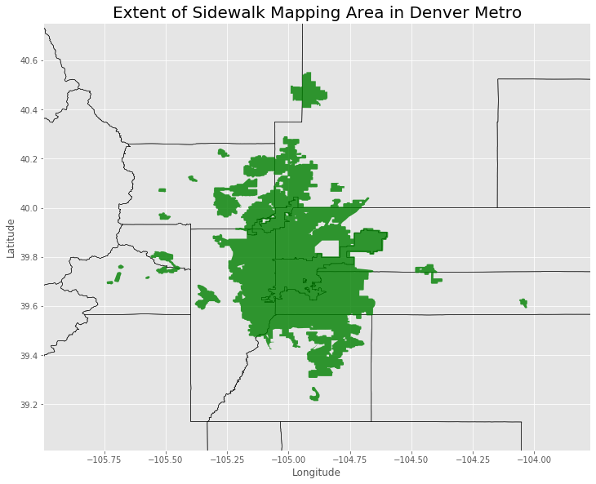
Data Scope:

Slide 3
Image Downloading Class
Class to download images with Latitude, Longitude, Heading, and Label
Generate Random point within survey region
Query streetview API for nearest image point
Confirm point is within street polygon
Find nearest street polygon edge & convert to direction
Test if sidewalk exists in direction within set distance
Save parameters and download image

Slide 4
Example Images with Validation

Slide 5
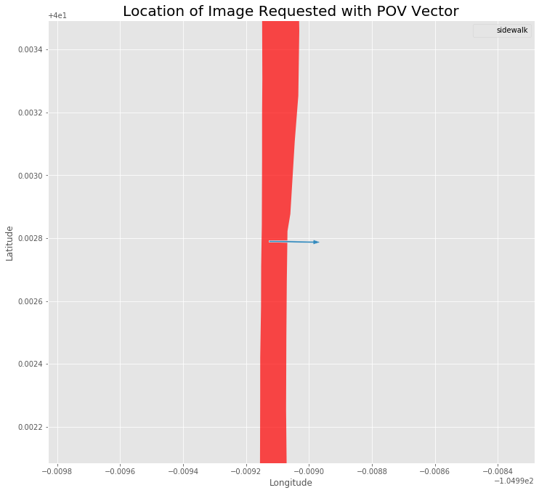
[268.79833469817083, [40.00278986277844, -104.9991271379266], 'no_sidewalk’]

Slide 6
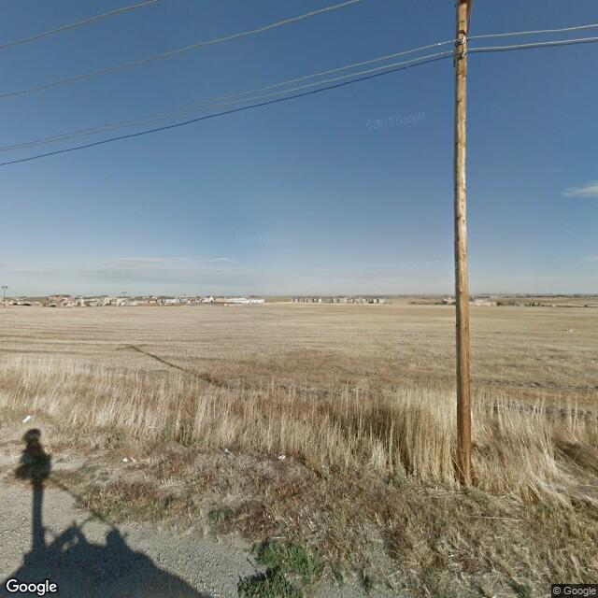
[268.79833469817083, [40.00278986277844, -104.9991271379266], 'no_sidewalk’]

Slide 7
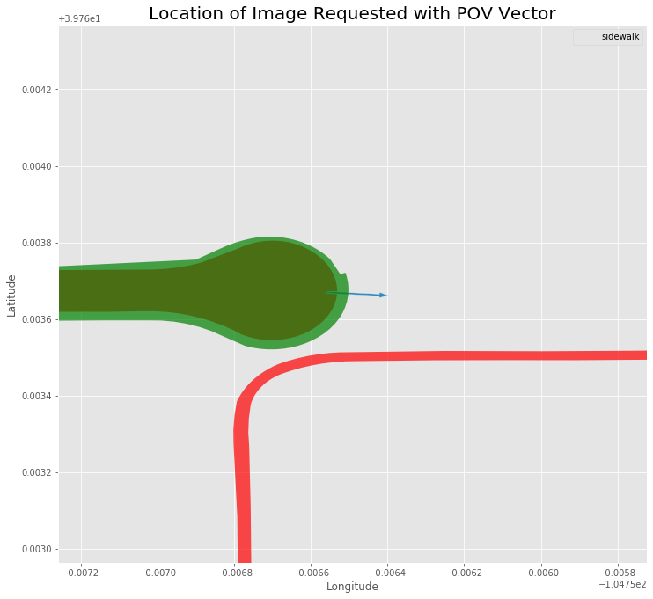
[93.8101431467257, [39.7636699, -104.7565609], 'sidewalk']

Slide 8
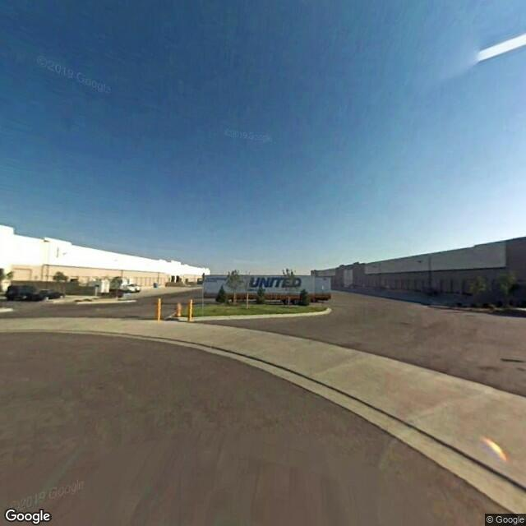
[93.8101431467257, [39.7636699, -104.7565609], 'sidewalk']

Slide 9
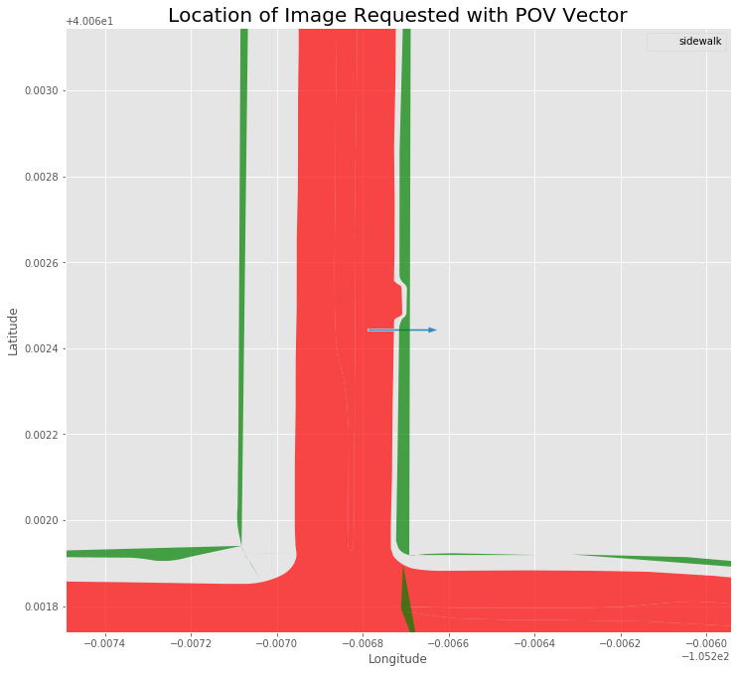
[269.9812922349449, [40.06244274355016, -105.2067883010862], 'sidewalk']

Slide 10
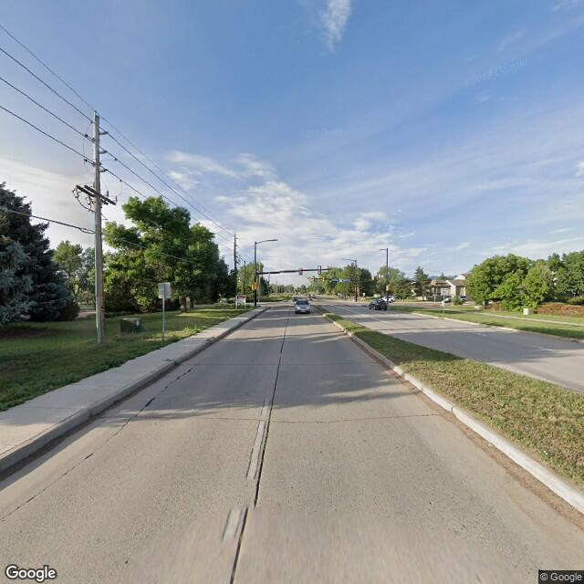
[269.9812922349449, [40.06244274355016, -105.2067883010862], 'sidewalk']

Slide 11
Issues with acquired data:
Around 15% of the images acquired had incorrect labels. This could be for multiple reasons:
new construction in last several years
partial sidewalk, where only a bit is in an image. How should we classify "partial sidewalk" in a binary classification task?
ambiguous 'sidewalks' - there are a range of slightly angle pavement edges to asphalt streets that could be considered curbless sidewalk, or just shoulder or open gutter.
some panoramas from google are rotated up to 90 degrees so may include part of the opposite road

Slide 12
Data Results:
The images covered most of the region
Non-sidewalk images generally were from outlying areas
Non-sidewalk images were less distributed

Slide 13
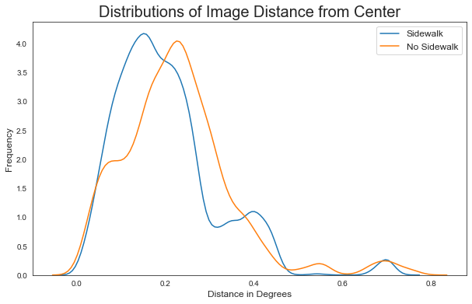
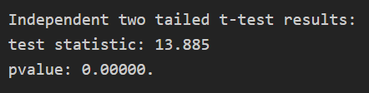
Data Results:

Slide 14
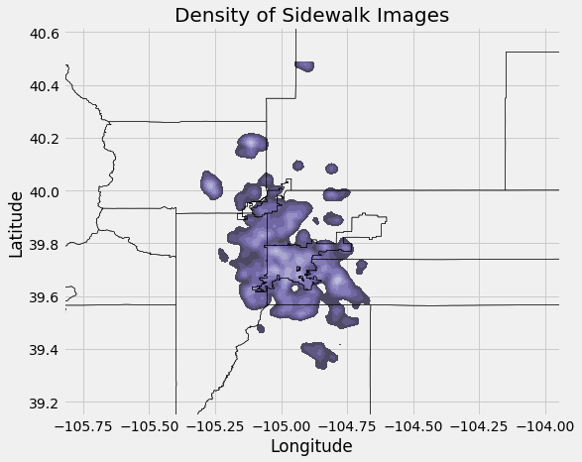
Data Results:

Slide 15
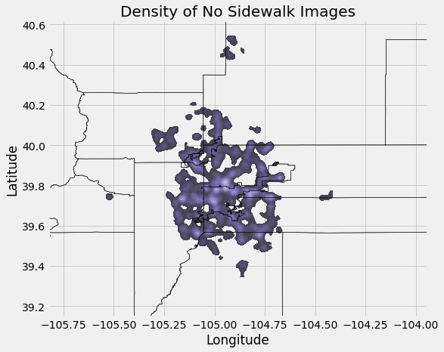
Data Results:

Slide 16
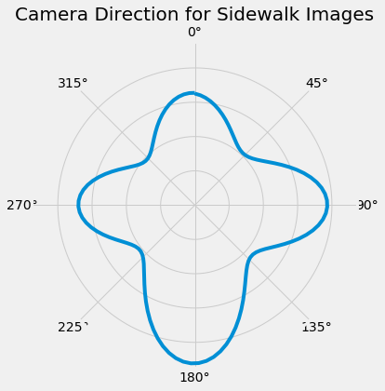
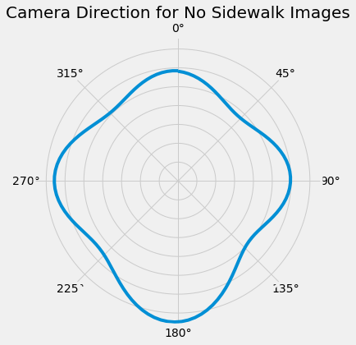
Data Results:

Slide 17
Modelling: Classification
Use tf.keras to build models:
Model with several convolutional layers
Pretrained models:
Mobilenetv3
Xception

Slide 18
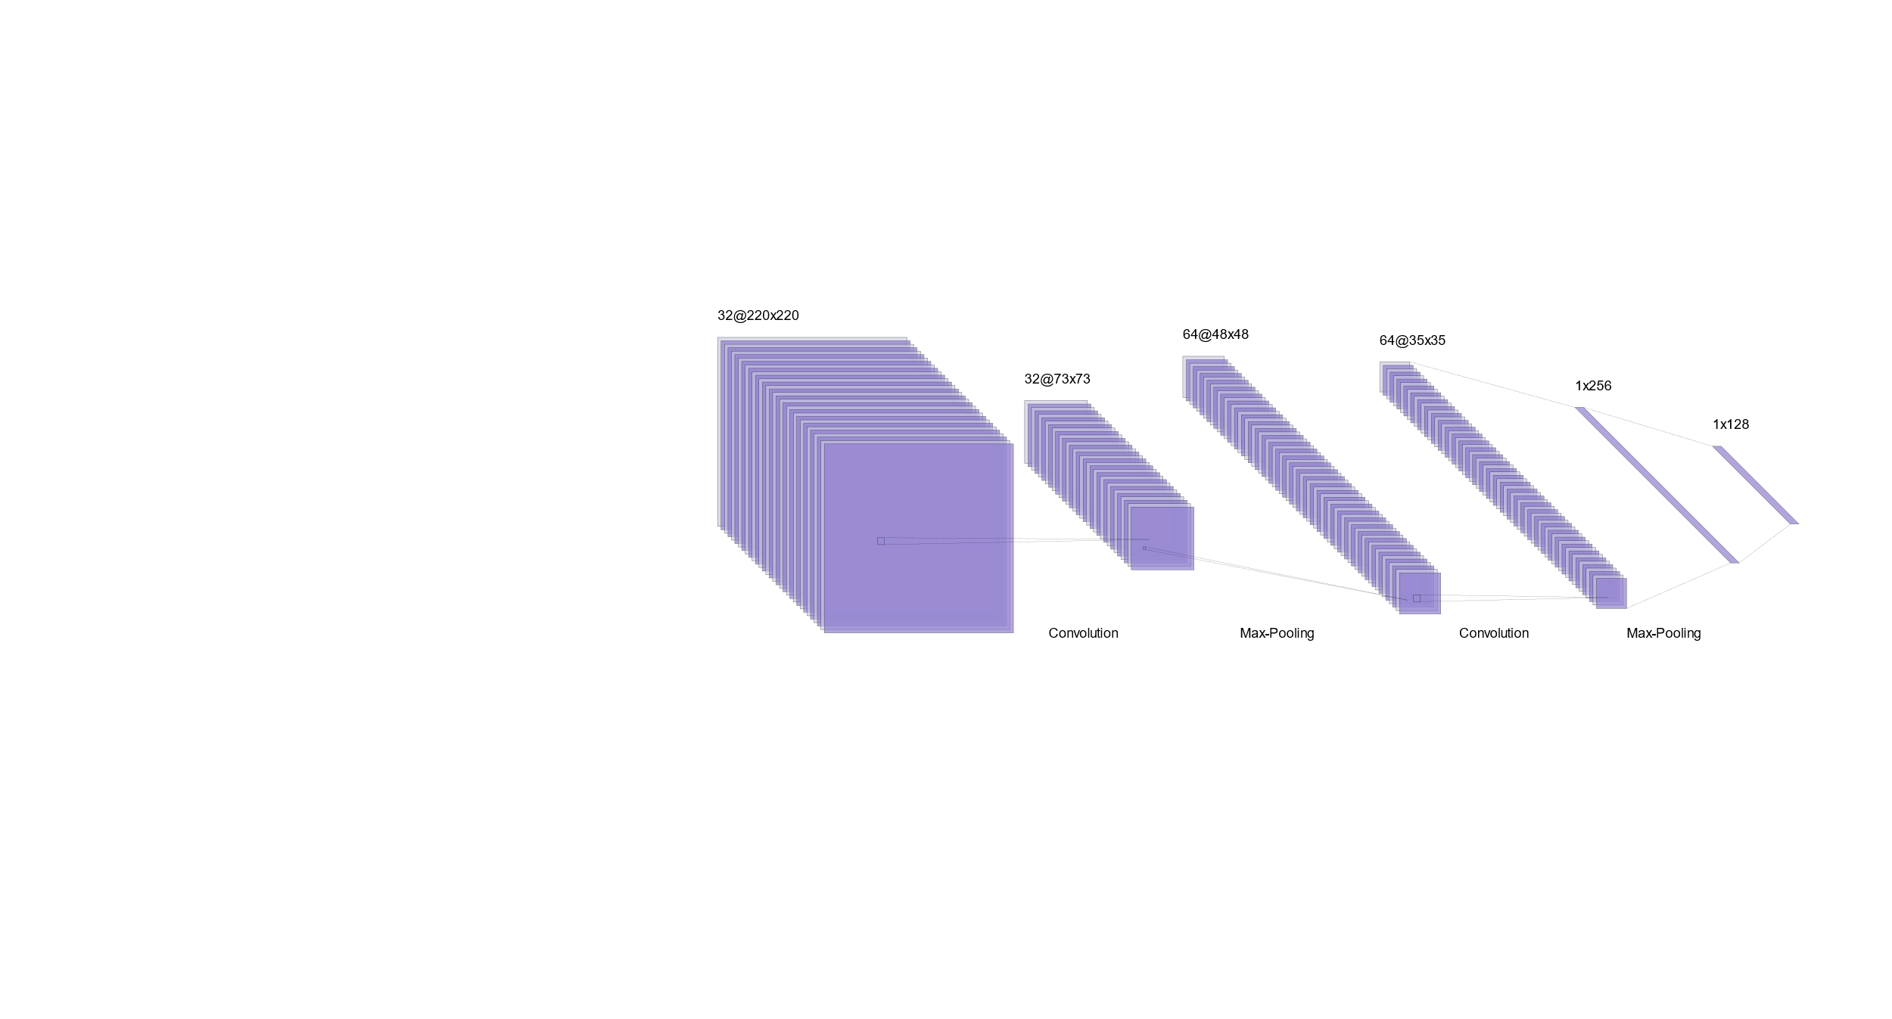
Modelling: Classification
Convolutional Model
Architecture:
Not including Dropout, BatchNormalization
RELU Activation (Sigmoid Final layer)
HE Uniform Kernel Initialization for Convolution layers
ADAM optimizer
Loss=Binary Cross-entropy
Metric for choice of saved model: Matthew Coefficient

Slide 19
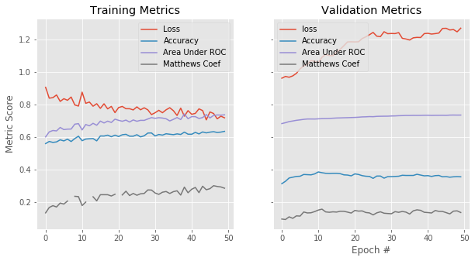
Modelling: Classification
Convolutional Model:
LR=0.000_1

Slide 20
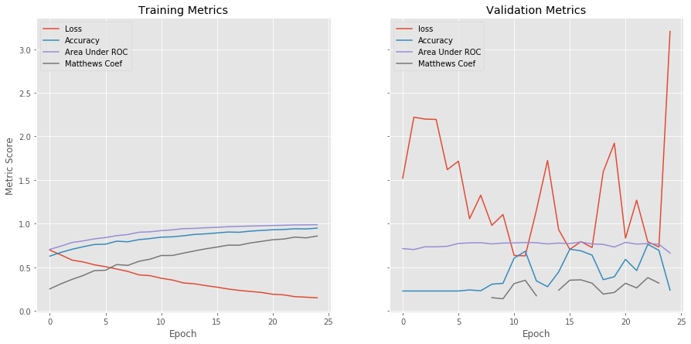
Modelling: Classification
Convolutional Model:
Learning Rate = .005

Slide 21
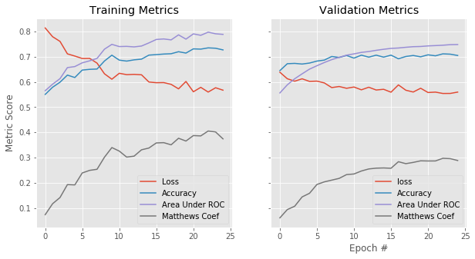
Modelling: Classification
Mobilenetv3

Slide 22
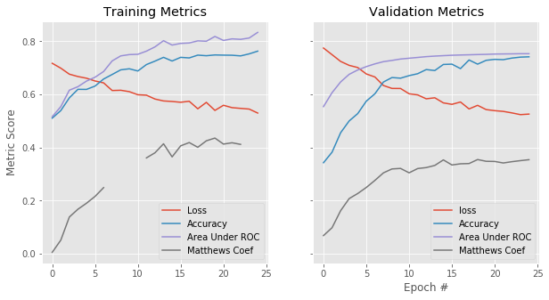
Modelling: Classification
Xception

Slide 23
Modelling: Image Segmentation
U-net Model
Encoders and Decoders, with skip connection

Slide 24
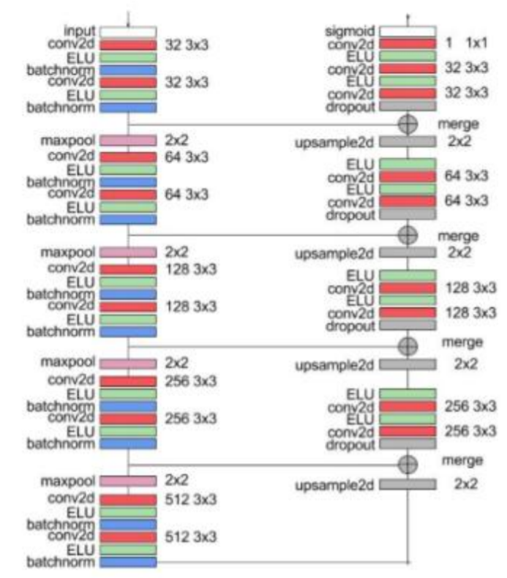
Architecture Design:
Ref: http://cs230.stanford.edu/files_winter_2018/projects/6937642.pdf

Slide 25
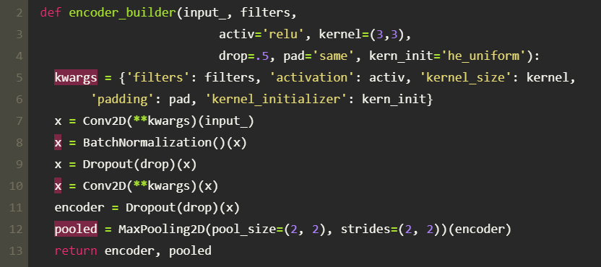
Modelling: : Image Segmentation
Encoder Block:

Slide 26
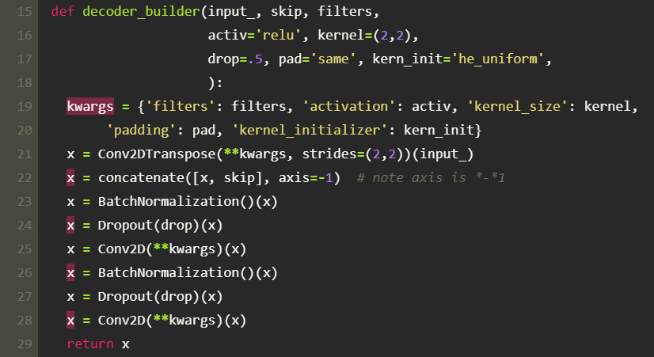
Modelling: Image Segmentation
Decoder Block:

Slide 27
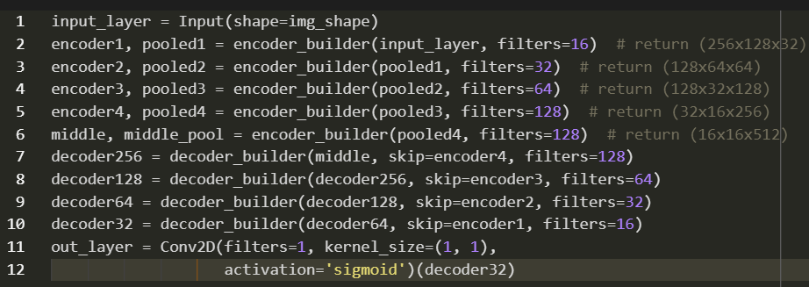
Modelling: Image Segmentation
Overall Structure:

Slide 28
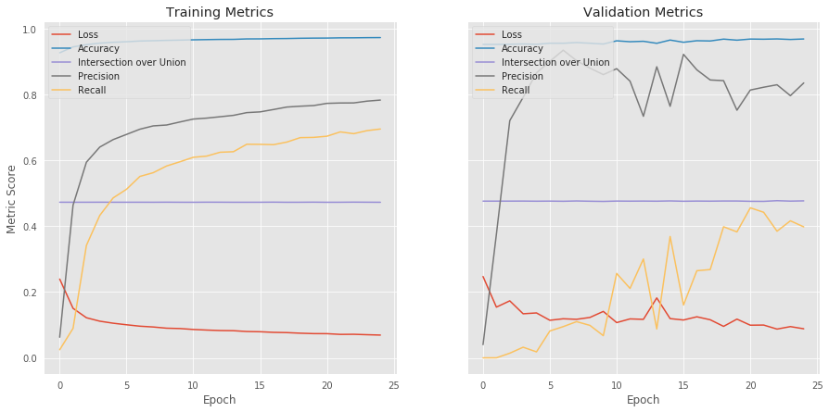
Modelling:
Learning Rate: .0001

Slide 29
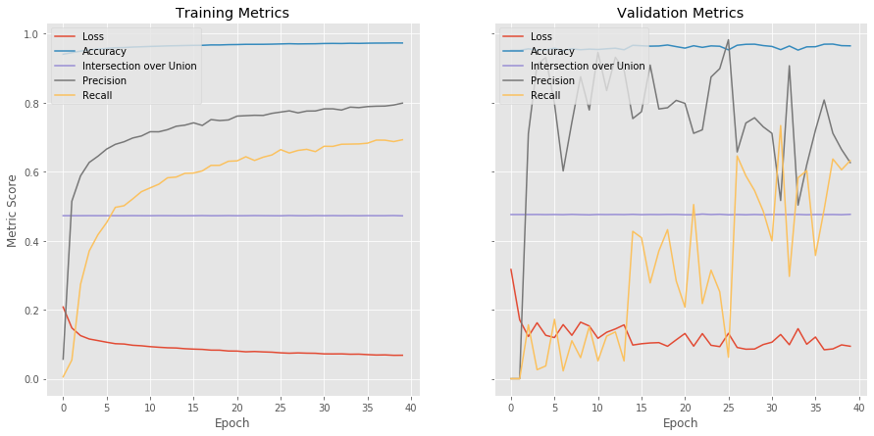
Modelling:
Learning Rate: .007

Slide 30
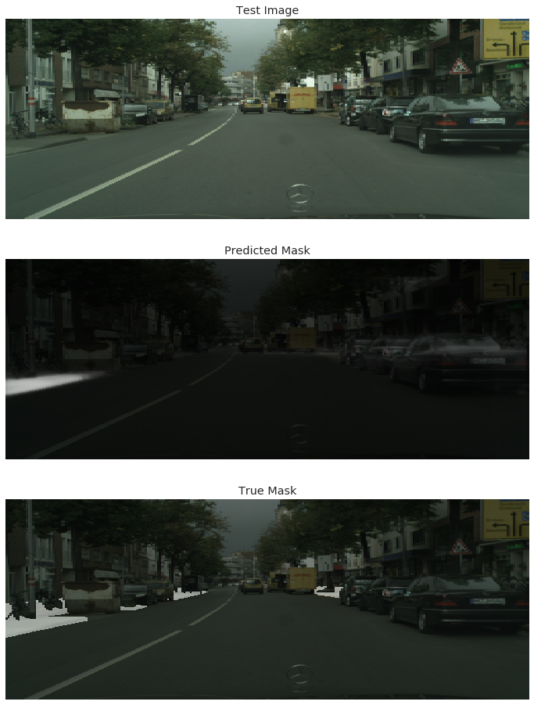
Modelling: Image Segmentation

Slide 31
Modelling: Image Segmentation

Slide 32
Modelling: Image Segmentation

Slide 33
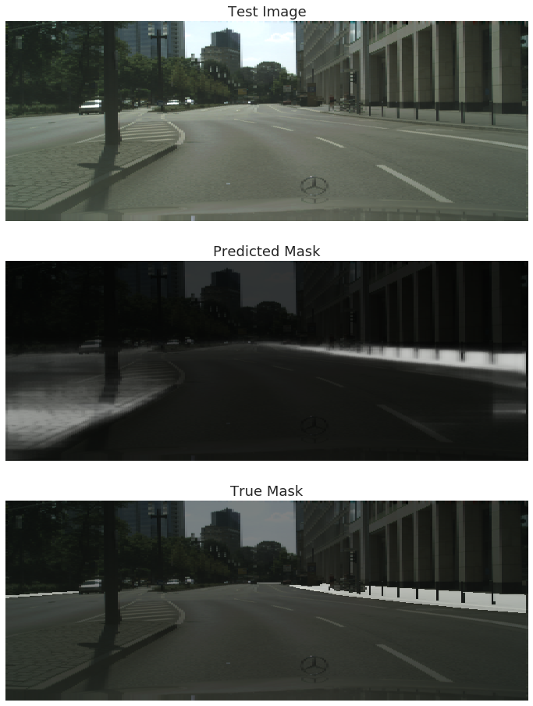
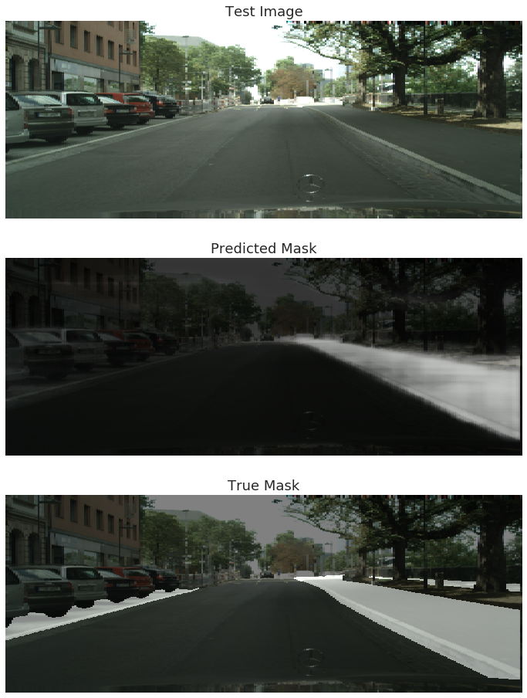

Slide 34
Modelling: Direct Transfer Learning
Use of trained U-net Model on Denver Street Images:

Slide 35
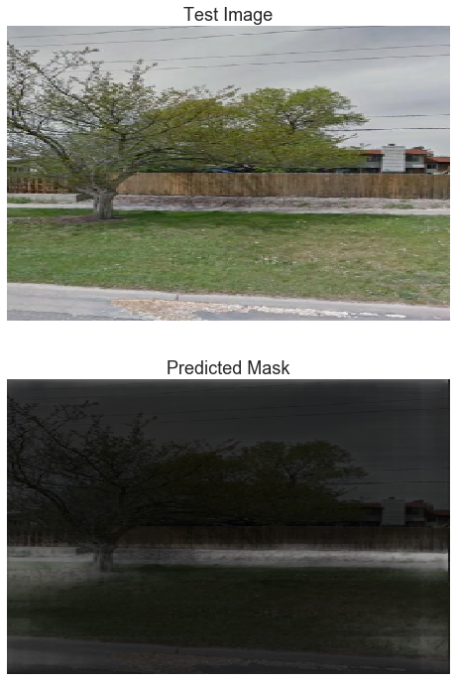

Slide 36
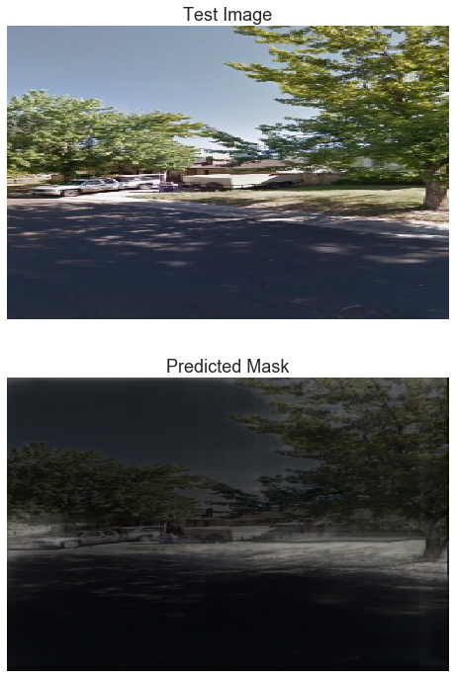

Slide 37
Modelling: Direct Transfer Learning
Images without Sidewalks:

Slide 38
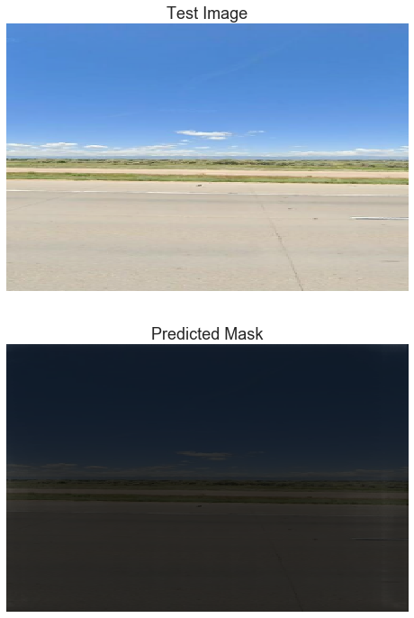

Slide 39
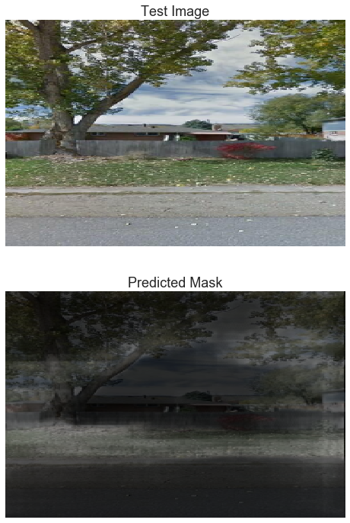

Slide 40
Known Problems
Misclassified images
Mean Intersection over Union measure stuck at 47%

Slide 41
Future Directions
Additional tuning of hyperparameters
Additional Data
Binary segmentation vs probabilistic
Pretrained backbone for Unet Model
Segmentation labeling the Denver dataset for additional training
Using segmentation model to classify

Slide 42
Questions?

